Slide 1


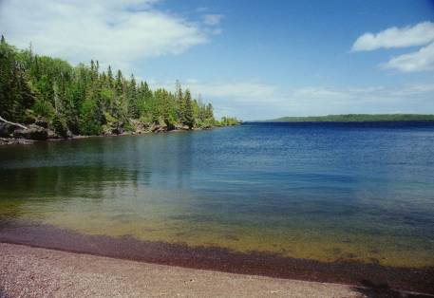
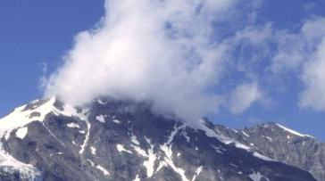
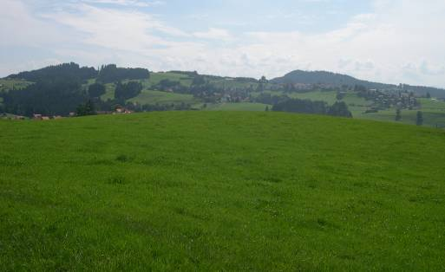
Sustainability Assessment of Urban Systems
(ENV-461) – Room MXF1
2: Sustainability issues in urban systems
Lecturers: Prof. Dr. Claudia R. Binder, Anne Boesch (OFS)
Assistants: Susan Mühlemeier, Livia Fritz, Franziska Meinherz,
Joao Meirelles, Thomas Bauwens, Jonas Mehr, Thibaud Rossel

Slide 2
Goals of the lecture
Overall Goal:
Understand different types of sustainability issues in urban systems and get some insights into how cities can approach them
Subgoals:
Understand what the key sustainability issues are in urban systems
Get an insight into key urban characteristics and the development of urban systems
Understand some relations between city size and environmental and economic impacts
Understand how cities are assessed in Switzerland
Transformation

Slide 3
Structure of the lecture
Summary of last week
Lecture
What is a city?
Sustainability issues in different cities
Group work on sustainability issues
Presentation and discussion of group results
Lecture
How do cities approach sustainability issues?
How is sustainability of cities assessed in Switzerland?

Slide 4
Summary last class: Kevin Bärenzung

Slide 5
What is a city ?
A city is a social, ecological, and economic system within a defined geographic territory.
They are associated it with
its functional or administrative region,
a critical mass and density of people,
man-made structures and activities (OECD and China Development Research Foundation 2010).
Cities are differentiated from other settlements by their population size and functional complexity (Fellmann et al. 1996).
The definition of cities varies significantly from nation to nation, and is not always dependent on population size but can also reflect administrative or historical status (Satterthwaite 2008).
Notes:
City definition from UNEP

Slide 6
Defintion of cities (II) (WBGU, 2016)
Statistical-administrative concept: It is determined using a nationally defined inhabitant threshold value, i. e. a
1) minimum number of inhabitants, and relates to the population within certain administrative borders (Fassmann, 2009: 43 and Gaebe, 2004: 19)
200 inhabitants (Iceland)
2,000 inhabitants (Germany)
10,000 inhabitants (Switzerland)
50,000 inhabitants (Japan)
2) minimum density; for example, a regional centre (Oberzentrum) in Germany must have at least 100 inhabitants per km² (Lichtenberger, 1998: 31).

Slide 7
City characteristics (I)
Minimum size and population density:
Compact settlement area
Functional structure:
Functions are spatially separated
Urban-rural linkages: Cities usually have an ‘excess significance ’ vis-à-vis rural settlements.
Imbalances in the fields of jobs, housing and services.
Functions can radiate internationally, cultural and financial centres.
Centres of innovation where new political and societal ideas evolve
(Heineberg, 2014; Fassmann, 2009; Zehner, 2001; Gaebe, 2004, WBGU, 2016):
Notes:
Functional structure
Especially in larger cities, the main business centre (City or central business district), residential districts, open spaces, local recreation areas, locations of manufacturing industries, etc., form a complex functional-spatial and often hierarchical structure of inner-city centres and sub-centres. The spatial distribution of economic sectors is influenced by real-estate and land markets.
Urban-rural linkage
i. e. they supply not only the local population, but also the hinterland with essential goods and services, e. g. in the fields of education, administration, retail trade or healthcare. They have a high proportion of employees in the secondary, tertiary and quaternary sectors. and technologies are developed, which then spread gradually or suddenly in the hinterland and beyond.

Slide 8
City characteristics (II)
Societal plurality:
Social, religious and ethnic diversity
Socio-economic disparities:
Disparities between socio-economic groups, which can also be reflected geographically by differences in inner-city design and the structure of land and rental prices
Artificial environmental design:
Cities are landscapes - reshaped and changed by people
Ecological problems are often externalized as a result of the city’s resource-dependence on the hinterland
The city environments have an ecological compensation function.
WBGU, 2017
Notes:
Social pluraility: resulting in a broad range of economic activities, population groups, income and life-style groups, and the formation of social groups and milieus.
Artificial design: as a rule they are subject to (excessive) ecological strain, e. g. by high emissions and soil sealing.

Slide 9
Natural cities
Natural cities refers to human settlements or human activities in general on Earth’s surface that are objectively or naturally defined and delineated from massive geographic information of various kinds and based on the head/tail division rule.
Do not necessarily depend on minimal population amount nor density
Information such as road network, social media data (Twitter, etc) are used to delineate human activities and relate them to “cities”

Slide 10
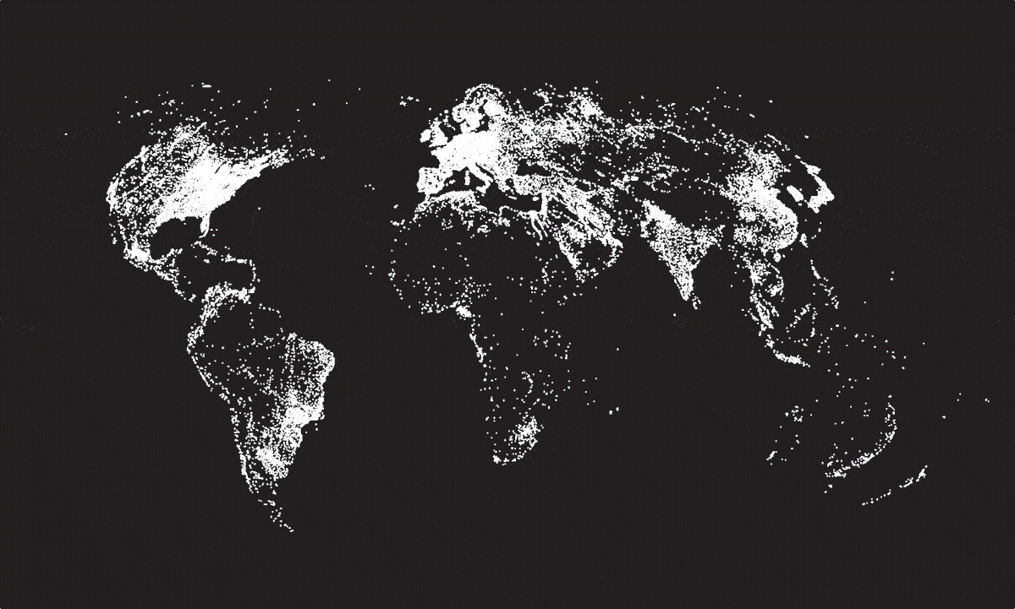
Natural Cities - from road network
Bin Jiang, Junjun Yin, Qingling Liu. (2015)
Notes:
City definition by looking for ‘natural’ cities

Slide 11
Natural Cities - from population
Bin Jiang, Yufan Miao. (2015)

Slide 12
Natural Cities - from social media
Bin Jiang, Yufan Miao. (2015)
Notes:
City definition by looking for ‘natural’ cities

Slide 13
Urbanization
https://www.youtube.com/watch?v=yKJYXujJ7sU&feature=share

Slide 14
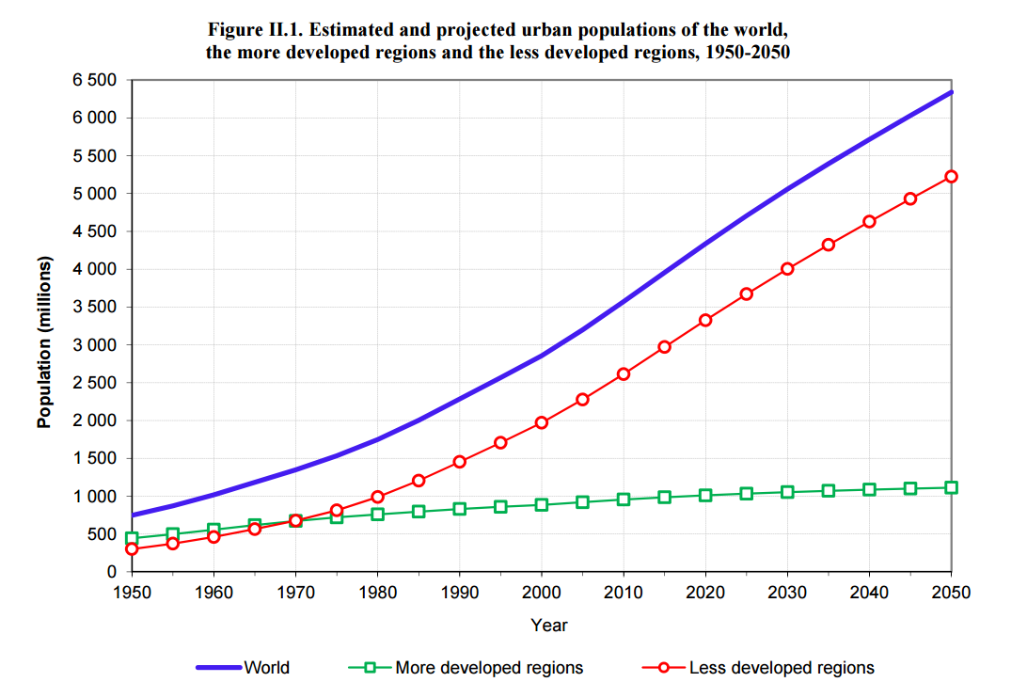
Urban growth concentrated in less developed regions
Heilig, Gerhard K. "World urbanization prospects: the 2014 revision."

Slide 15
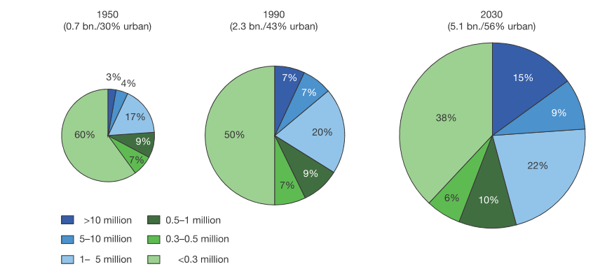
Global urban distribution by city class
WBGU 2016

Slide 16
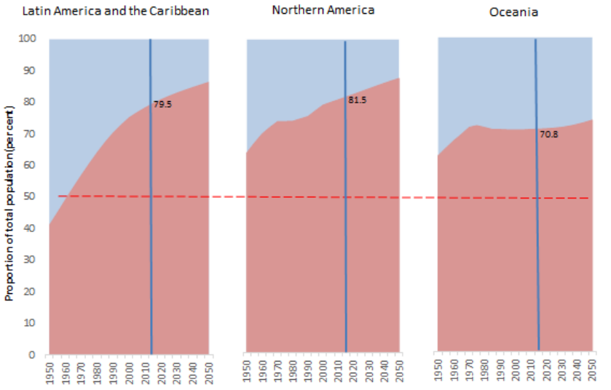
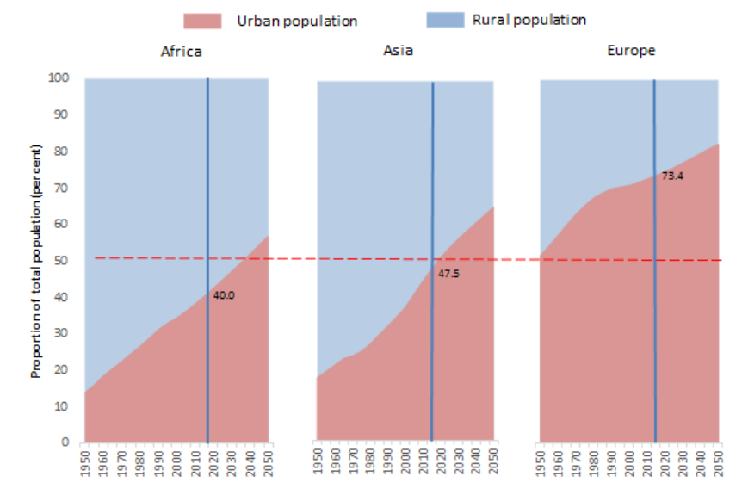
Urbanization saturates in the developed world
Proportion of total population in percent
Heilig, Gerhard K. (2015).

Slide 17
Urbanization still to grow in Africa and Asia
Heilig, Gerhard K. (2015).

Slide 18
Exemplary fields of action Opportunities and challenges of cities

Slide 19
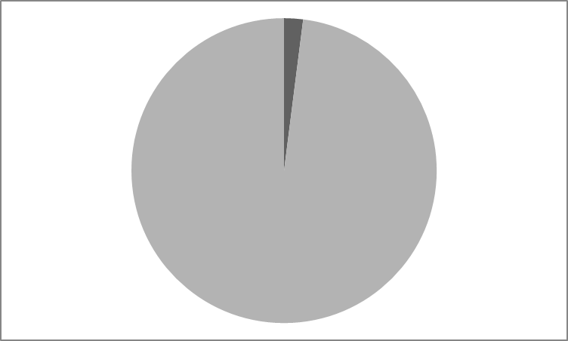
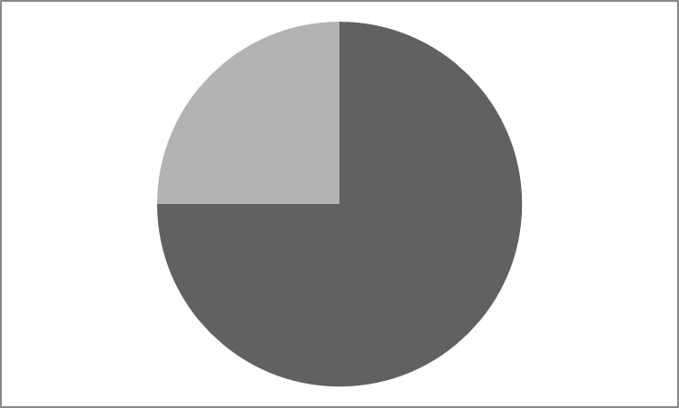


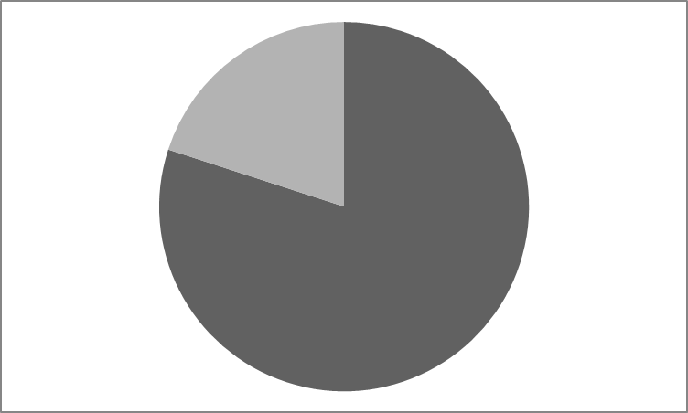
Global impact of cities
Cities cover 3% of the world’s surface …
cause 75% of the world’s CO2 emissions …
produce 50% of the world’s waste …
consume 75% of the natural resources …
house 54% of the world’s population …
generate 80% of the world’s GDP.
UNEP

Slide 20
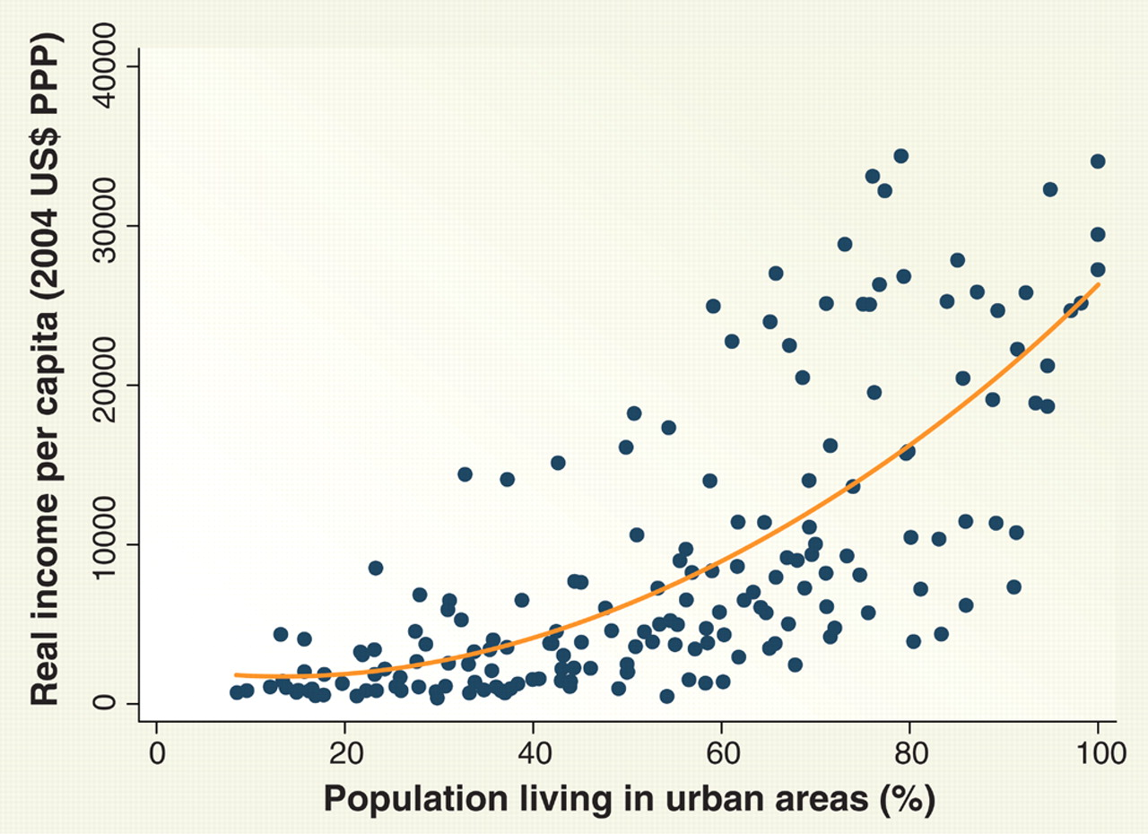
Urbanization and the Wealth of Nations
http://science.sciencemag.org/content/319/5864/772.full

Slide 21
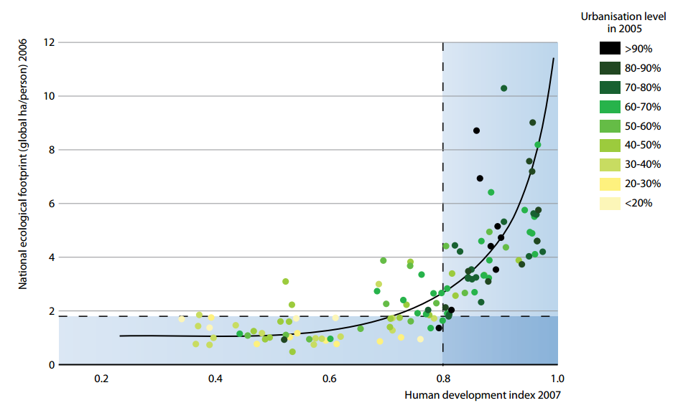
Ecological footprint, HDI and urbanization level
Programme des Nations Unies pour l'environnement. 2011

Slide 22
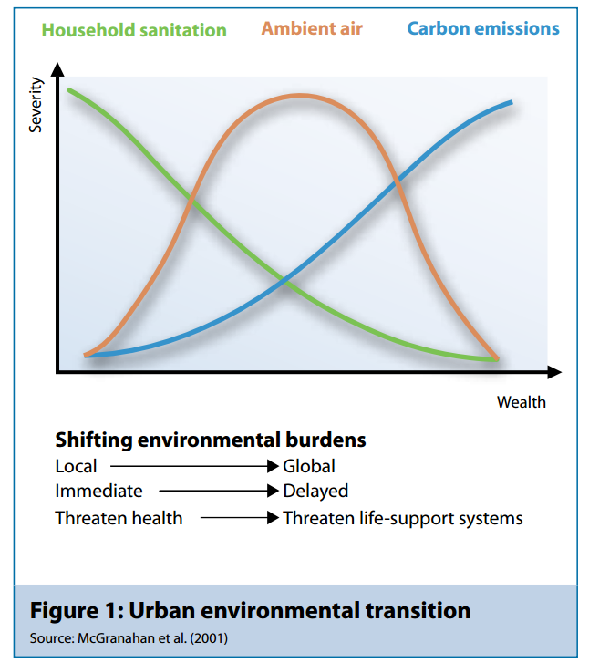
Shift of environmental impacts with increasing wealth
Programme des Nations Unies pour l'environnement. 2011

Slide 23
Life expectancy and Carbon emissions
Steinberger et al., 2012

Slide 24
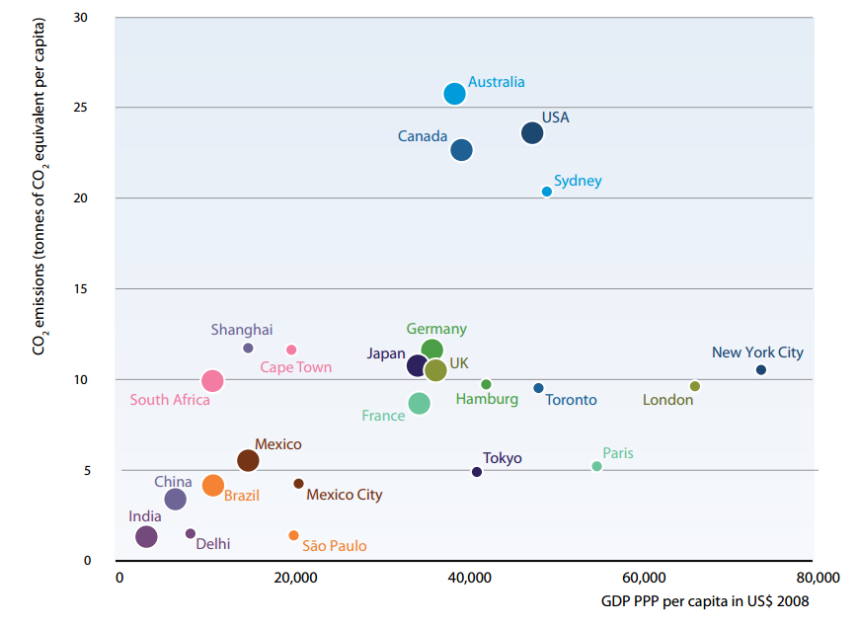
Cities emit less CO2 / cap. than the countries they belong to
Programme des Nations Unies pour l'environnement. 2011

Slide 25
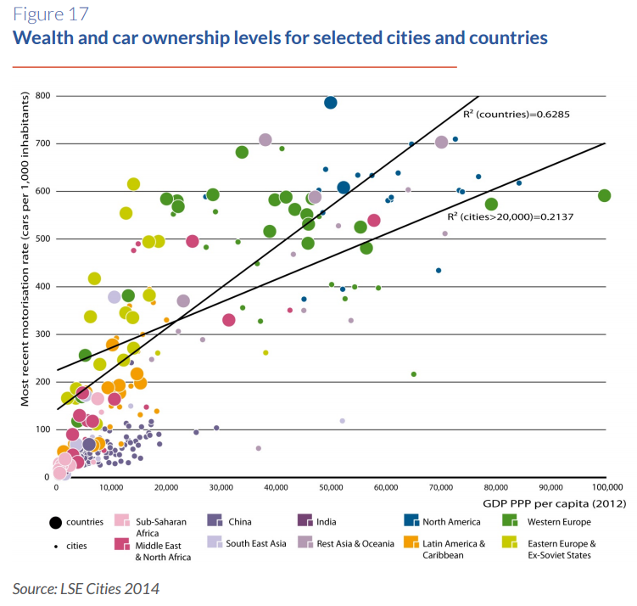
Wealth and car ownership

Slide 26
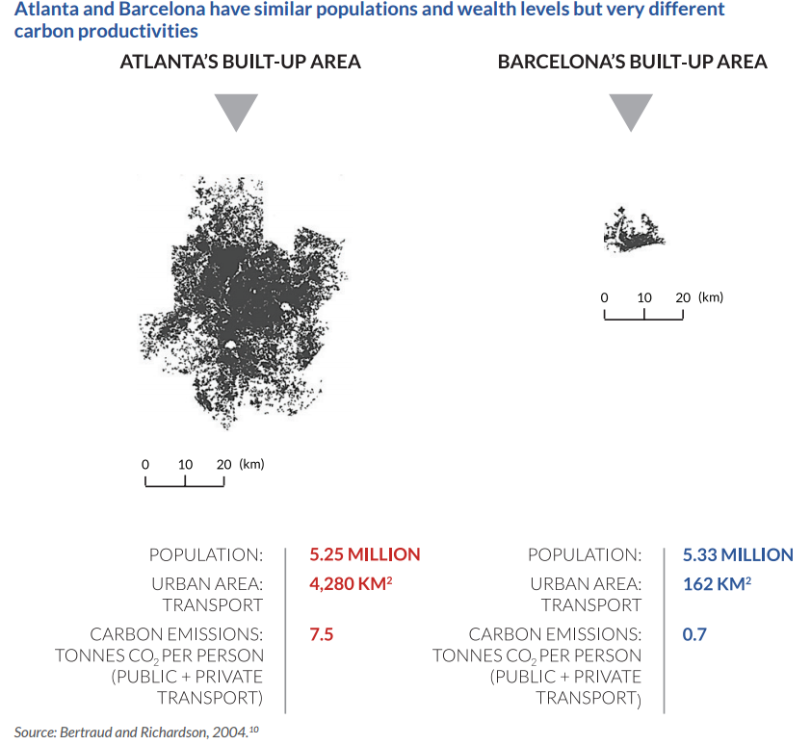
City density matters

Slide 27
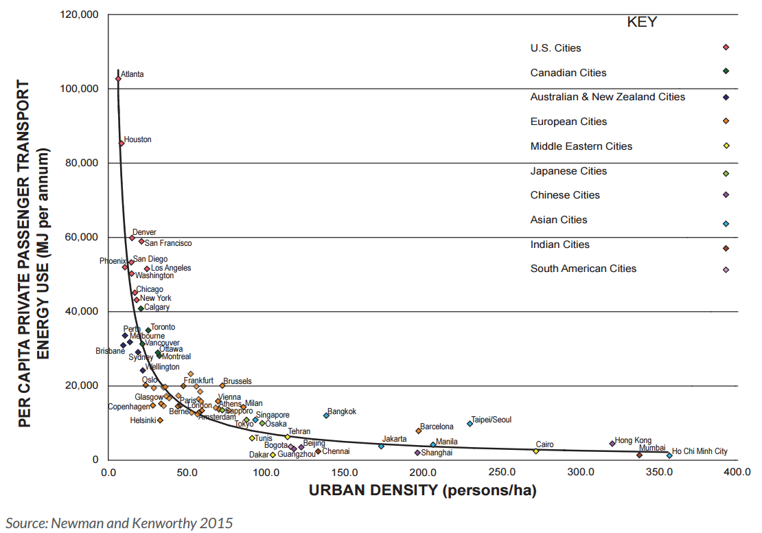
Urban private passenger transport energy demand
Rode, Philipp, et al. 2017

Slide 28
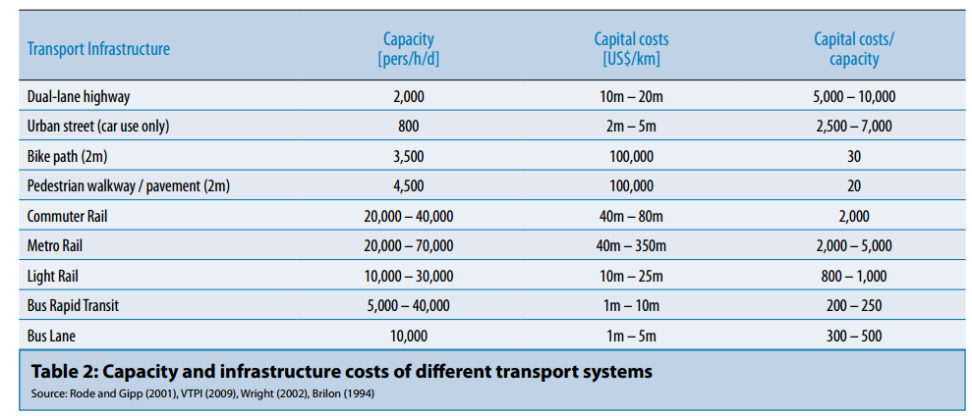
Economic benefits: Transport systems
Programme des Nations Unies pour l'environnement. 2011

Slide 29
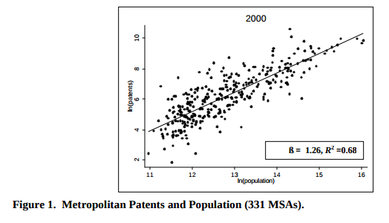
Metropolitan patents related to population in cities
Bettencourt, et al. 2004

Slide 30
Urban mobility in upheaval.
WBGU 2016, based on Hidalgo and Zeng, 2013

Slide 31
Air pollution in three approx. equal-sized megacities
Particulates (PM10: thin, shaded lines)
Groundlevel ozone (O3: thick, solid or dotted lines).
Average city size (number of inhabitants: black, dashed line)
Source: WBGU 2016

Slide 32
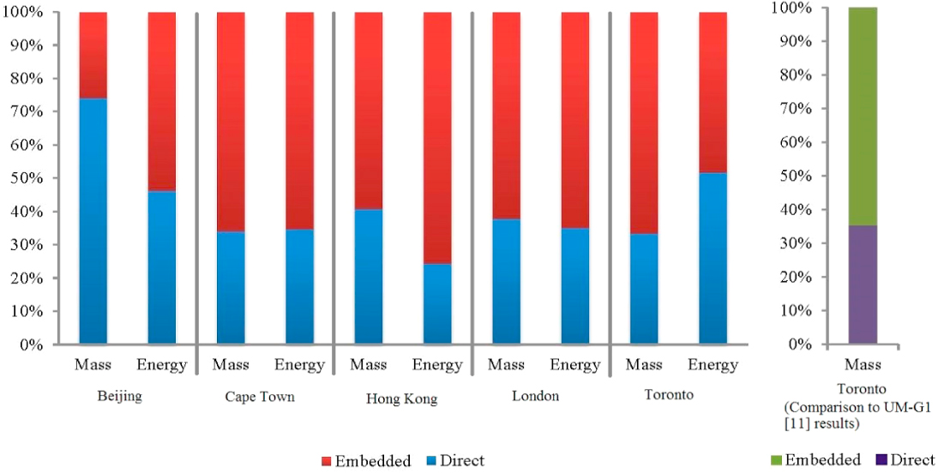
Embedded and direct energy and mass flows
Beijing
Cape Town
Hong Kong
London
Toronto
Population density residents/ km-2
1016 1239 6480 4978 878
Goldstein et al. (2013)

Slide 33
Summary and open questions
Urbanization is an ongoing process:
About 56% urban in 2030 (WBGU, 2016)
More megacities (hosting 15% of the population in 2030)
Advantages of urbanization
Innovation potential (patens)
Public transport
Economies of scale: cost efficiency
Less pollution due to density
However:
Pattern is not the same for all cities
Embedded materials and energy increase with increasing density
Notes:
e.g., high diversity of impacts with similar incomes

Slide 34
Open questions regarding sustainability assessment
Which sustainability issues are most relevant on the different levels of an urban system (neighborhood, …).
What are adequate indicators? Can we use the SDGs for sustainability assessment?
What are trade-offs when developing policies for increasing sustainability in cities? E.g. should we favor density and increase embedded flows? What are the difficulties in designing policies for sustainable cities?

Slide 36
World café

Slide 37
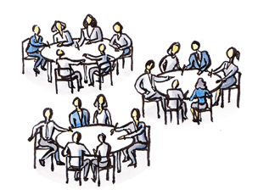
Method – World café
3 questions
6 tables
6 people per table
3 rounds
8-10 min per round
Discussion at the table
2 x change of tables (the host stays)
Final wrap-up by the host

Slide 38
The transition town movement

Slide 39
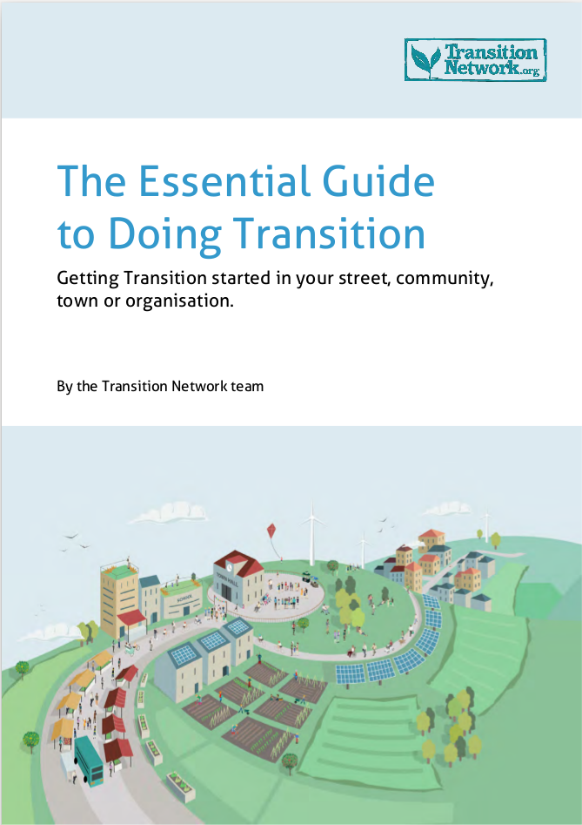
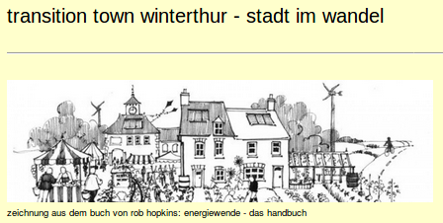


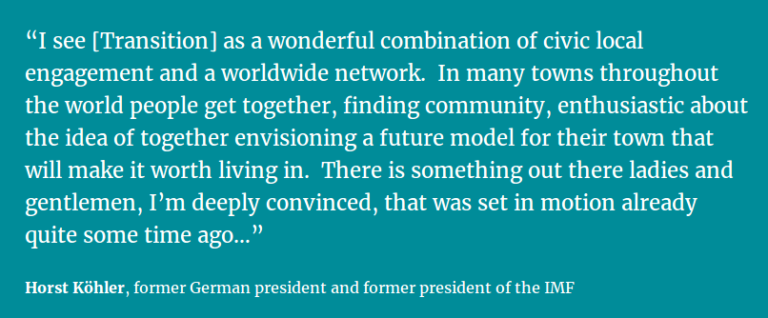




The transition town movement

Slide 40
Transition town movement
Transition towns:
Tackle global challenges with local initiatives – make big problems manageable by starting in one’s neighbourhood
Aim to create a different future in terms of the…
… environment (reduce dependence on fossil fuels, combat climate change etc.)
… society (caring culture, supporting each other, getting to know each other)
… economy (REconomy – an economy to create livable places and happy people, and of which the benefits are distributed evenly amongst everybody)
In short: Create opportunities from the failures of the current system

Slide 41

Transition town movement
Principles:
Acting with…
… the head – based on the best available information and the collective intelligence
… the heart – driven by passion and compassion
… the hands – creating tangible and practical projects
Respect resource limits & create resilience
Promote inclusivity & social justice
Promote subsidiarity
Pay attention to balance
Create an experimental & learning environment
Freely share ideas and power
Collaborate & look for synergies
Foster positive visioning & creativity

Slide 42

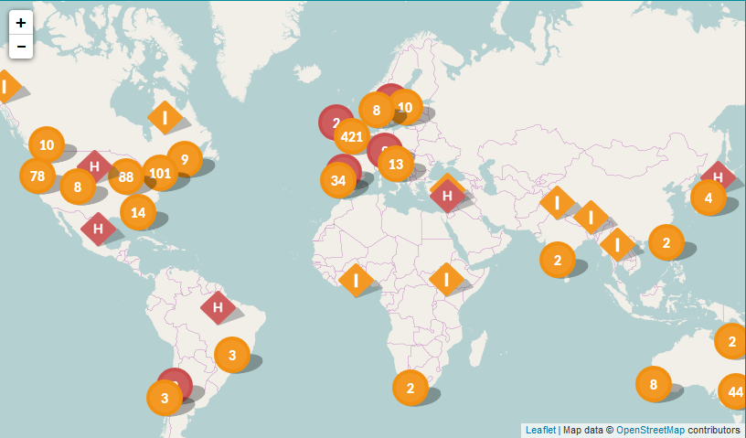
Transition town movement
In practice:
2006: First transition town – Totnes (UK)
Since then: A growing number of initiatives around the globe

Slide 43
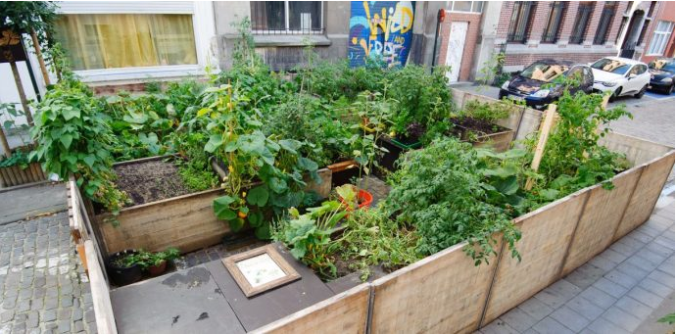
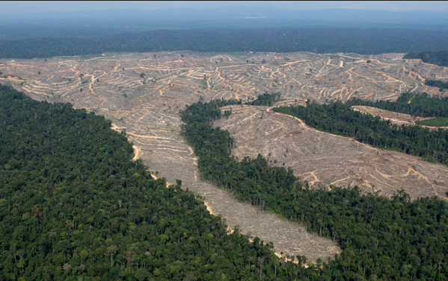
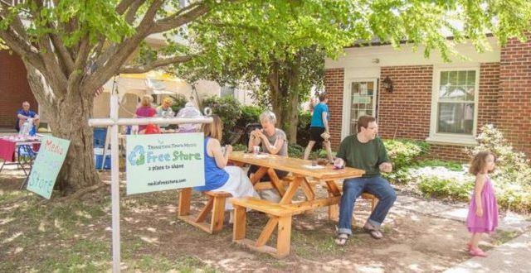
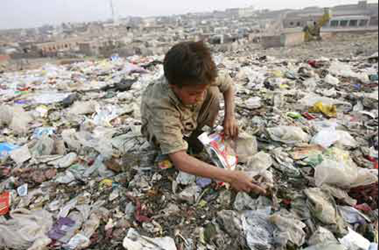
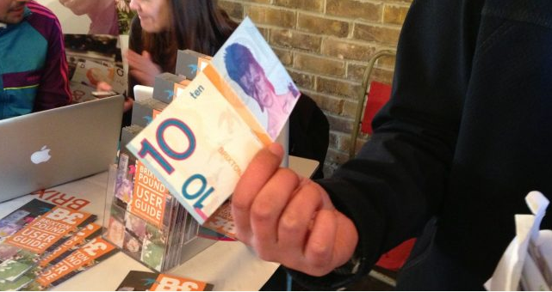
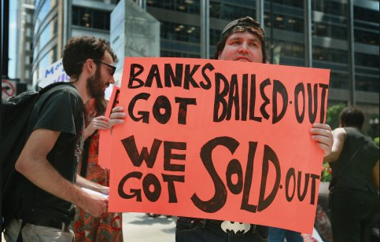
Transition town movement
Can
It
Work
?
How can we measure whether it did?

Slide 44
What do we do in Switzerland? How do we assess the sustainability of Swiss cities?

Slide 45
Exercises

Slide 46
Are these five city projects sustainable from your point of view? Why ?
https://www.youtube.com/watch?v=vG0ZShzIoMo

Slide 47
Alternative options
Eco-city
https://www.youtube.com/watch?v=7ygw2L-Qi0c
Sustainable cities – how can we assess them? (WBCSD) – utility of business
https://www.youtube.com/watch?v=fcDDUSUbq9A
Green growth in Asia
https://www.youtube.com/watch?v=NXBopuAyO0w

